Slide 1
Weeks 3&4 Exercises
Dhiraj Bankar
April 10, 2021
Bellevue University
DSC640 – Data Presentation & Visualization

Slide 2
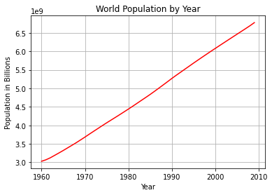
Python – Line Chart

Slide 3
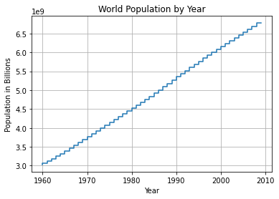
Python – Step Chart

Slide 4
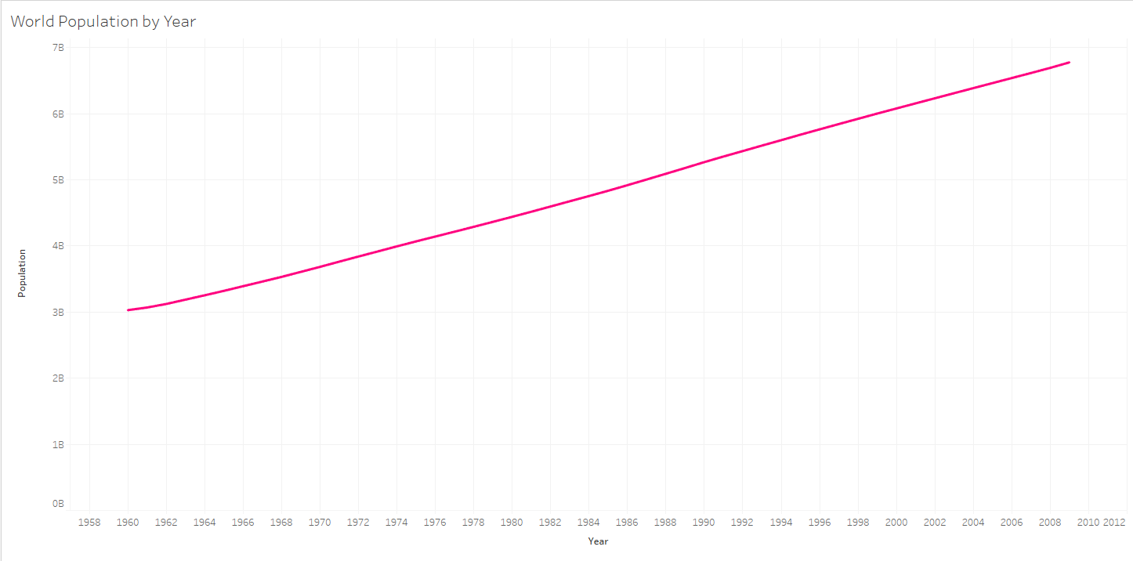
Tableau – Line Chart

Slide 5
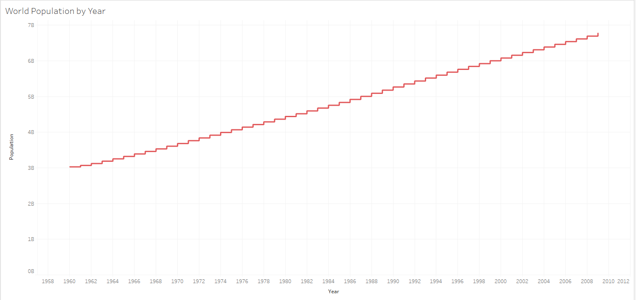
Tableau – Step Chart

Slide 6
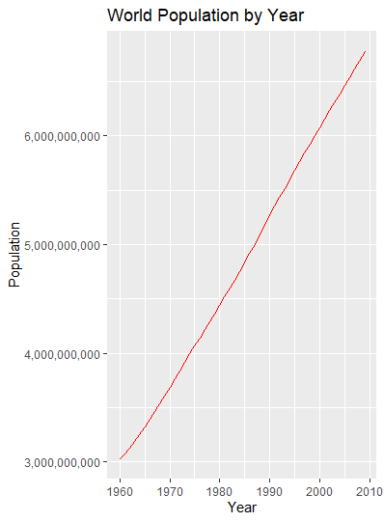
R – Line Chart

Slide 7
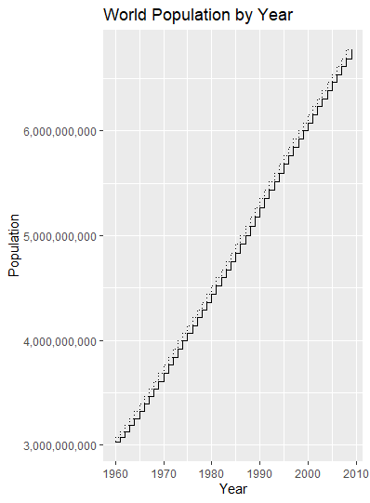
R – Step Chart

Slide 8
References
Data came from zip file under 2.2 Exercises: Line Charts and Step Charts tab. Used world-population
Python step chart reference used: https://matplotlib.org/3.1.1/api/_as_gen/matplotlib.pyplot.step.html
Tableau line chart reference used: https://help.tableau.com/current/pro/desktop/en-us/buildexamples_line.htm
Tableau step chart reference used: https://www.tableau.com/about/blog/2018/3/make-your-regular-lines-step-and-jump-83292
R – line chart reference used: http://www.sthda.com/english/wiki/ggplot2-line-plot-quick-start-guide-r-software-and-data-visualization
R – step chart reference used: http://sape.inf.usi.ch/quick-reference/ggplot2/geom_step

